Slide 1

Public Access in Nashville
A data story

Slide 2


Introduction

Slide 3
Summary & Motivation
Summary
I want to explore what publicly accessible resources are available.
This will be accomplished by analyzing how those recourses are dispersed by zip code in relation that areas economics.
Motivation
I believe that we should have our human needs met automatically, but as a society we fall short sometimes. My main motivation is surviving in the city as an unhoused person. I wanted to see how accessible those resources are to survive and get out of a difficult situation

Slide 4
Defining Public Access
Water
Social Services (food)
Wi-fi
Libraries
Public Health Clinics
Prescription Disposal Locations
Fire Departments
Police Departments
These are some of the relevant metrics I was able to find data on.

Slide 5
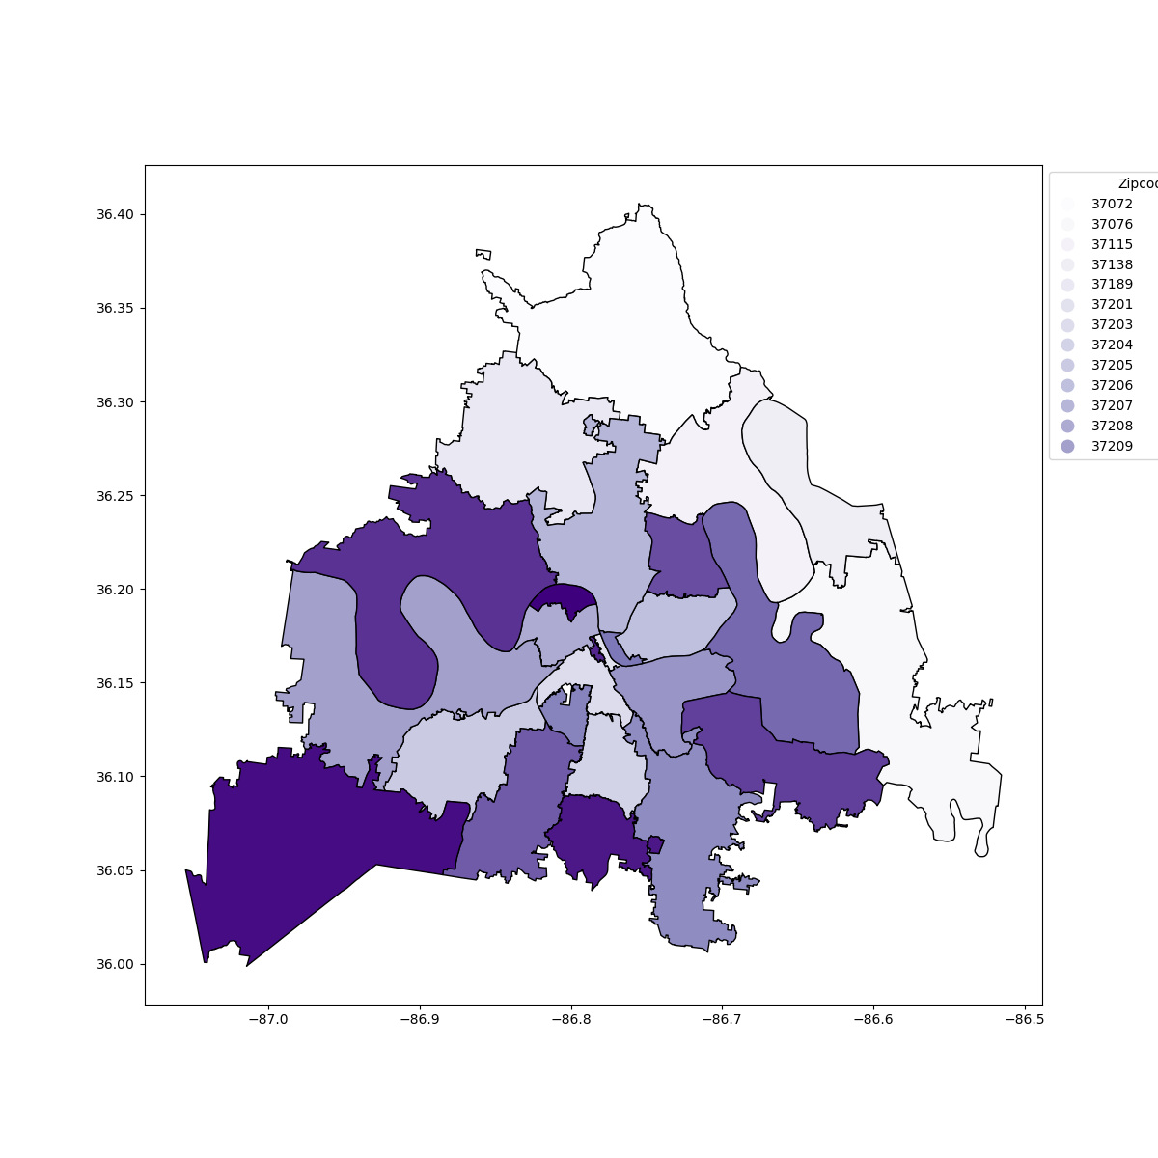
Zip-codes observed
37072
37076
37115
37138
37189
37201
37203
37204
37205
37206
37207
37208
37209
37210
37211
37212
37213
37214
37215
37216
37217
37218
37219
37220
37221
37218

Slide 6
How does income/population correlate to access to public resources in Nashville?

Slide 7
What area has the most access? What area has the least?
Most access
Least access

Slide 8
Does public wi-fi access directly correlate with population? Or unemployment?
population
unemployment

Slide 9
Making an area score

Slide 10
Area score takeaways

Slide 11

Dashboard

Slide 12
Future goals ~ re-analyze based on neighborhoods ~ add other economic correlations
Data Sources: https:// data.census.gov (American Community Survey 2022)
https://data.nashville.gov/

